Slide 1
PSCS_8 - "AI-powered Legal Assistant "
PIP4004 Capstone Project
VIVA VOCE
Batch Number: CSE - G39
Under the Supervision of,
Ms. Sreelatha PK
Assistant Professor
School of Computer Science and Engineering
Presidency University
Roll Number | Student Name
20211CSE0846 | VAISHNAVI C
20211CSE0298 | SHRUTHI V
20211CSE0308 | RUTHIKA S SHETTY
Name of the Program: CSE
Name of the HoD: Dr. Asif Mohammed H.B
Name of the Program Project Coordinator: Dr. Jayanthi. K

Slide 2
Problem Statement Number:
Organization: Presidency University
Category (Hardware / Software / Both) : Software
Problem Description: PSCS_8 - "AI-powered Legal Assistant"
Difficulty Level: Simple

Slide 3
Introduction
This project presents a conversational legal assistant built with Python and NLP, hosted on Google Colab.
Retrieval-based QA system provides accurate, real-time legal query responses.
Built with ipywidgets, it offers a clean, interactive interface with real-time responses and structured answers.
Reduces consultation time and cost, ideal for self-help, education, and pre-consultation.

Slide 4
Literature Survey
Paper Title | Authors | Findings | Drawbacks
AI-powered Legal Document Simplification | Rithik Raj Pandey et al | Uses GPT-3.5/4 for summarization, OCR for text extraction, and pattern recognition to identify clauses. Simplifies legal documents and supports chatbot integration. | Only works on public legal documents; may miss full legal context.
LLMs for Legal Drafting and Summarization | Awez Shaikh et al | Uses GPT and NLP for dynamic contract creation and summarization. Includes OCR and ensures customization with security. | May produce hallucinations and factual inaccuracies.
LawGPT 1.0 - Legal Assistant | Nguyen Ha Thanh | GPT-based multilingual legal assistant using transformers and attention mechanisms. | Not fine-tuned for legal specifics; lacks accuracy in complex queries.

Slide 5
Literature Survey
Paper Title | Authors | Findings | Drawbacks
AI for Contract Drafting and Document Automation | Imogen Vimala et al | Uses NLP and Collect.chat for chatbot-driven contract creation. Automates standard documentation tasks. | Limited to predefined formats; lacks legal reasoning capability.
Legal Document Simplification in India | G. Kiran Kumar et al | Uses OCR and NLP to simplify legal documents like PILs and affidavits, tailored for Indian legal context and languages. | Less effective with non-standard document formats.
ChatLaw: AI Legal Assistant | Jiaxi Cui et al | Applies RAG, and multi-agent system to simulate law firm environment and deliver legal answers. | High resource requirements; still prone to hallucination.
Legal LLMs and Challenges | Jinqi Lai et al | Reviews GPT, LawGPT, ChatLaw, and BERT in law; focuses on trust, interpretability, and risks. | Does not provide technical or implementable solutions.

Slide 6
Existing Method Drawback
Poor-Quality and Biased Data.
Wrong or Made-Up Answers.
OCR Limitations.
Privacy and Security Issues.
Dataset Limitations.

Slide 7
Proposed Method
Purpose: Develop an AI-powered Legal Assistant using a systematic approach for accuracy and efficiency.
Methodology: Divided into 5 key stages:
1. Data Gathering
2. Preprocessing
3. Model Development
4. Document Retrieval
Functionality: Understands legal terminology, extracts key information, and answers queries accurately.
Outcome: Provides a reliable, context-aware tool for legal research and document management.

Slide 8
Proposed Method
1. Data Collection & Preprocessing​
Sources: Case laws, contracts, notices, public legal repositories​
Cleaning Steps: Remove special characters & formatting errors.​
2. AI Model Development​
Embeddings via Hugging Face Transformers​
Dimensionality Reduction using PCA​
Similarity Search using FAISS + HNSW​
Conversational Retrieval
​
3. Document Retrieval​
Query Embedding → Similarity Matching​
Dynamic Filtering & Ranking : Relevance-based, Adaptive to user context​

Slide 9
Objectives
Objective 1: Simplify Legal Language for Everyone
Legal language is often too complex for non-lawyers.
NLP will be used to convert legal terms into plain, everyday language.
Helps individuals and small businesses understand rights, responsibilities, and contract terms clearly.
Objective 2: Improve Access to Affordable Legal Help
Legal services are often costly and inaccessible.
Helps reduce dependency on legal experts.
Aims to equalize access to legal services.
Objective 3: Offer Interactive Legal Assistance via Chatbot
Smart chatbot for legal queries and document requests
Uses conversational AI and context-aware retrieval
Assists in legal document creation like an intelligent assistant

Slide 10
Outcomes/ Results Obtained
Automated Legal Document Generation – Generates plain-language legal response based on user input.
Improved Accessibility to Legal Resources – Enables individuals and small businesses to create legal documents without legal expertise.
Time and Cost Savings – Saves time and reduces legal expenses.
Integration with Legal Databases – Aligns documents with current legal standards using public legal resources.

Slide 11
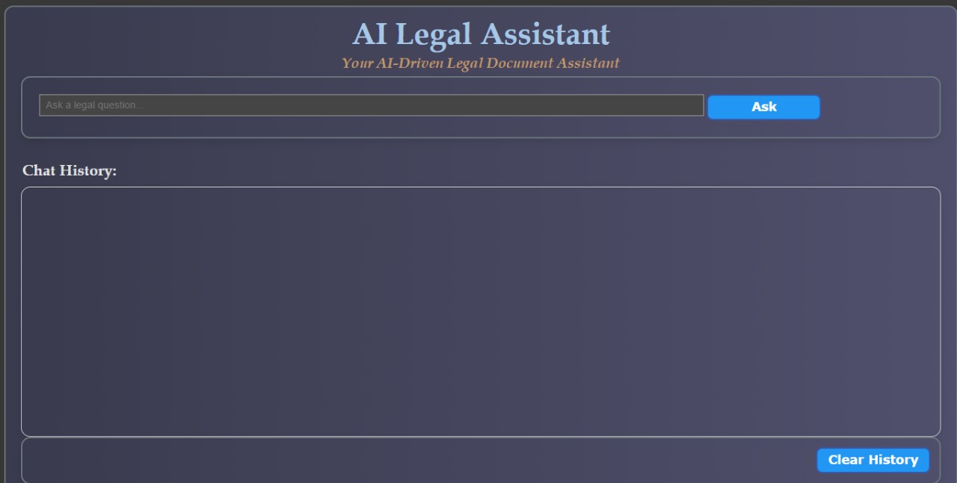
Outcomes/ Results Obtained
AI Chatbot Interface

Slide 12
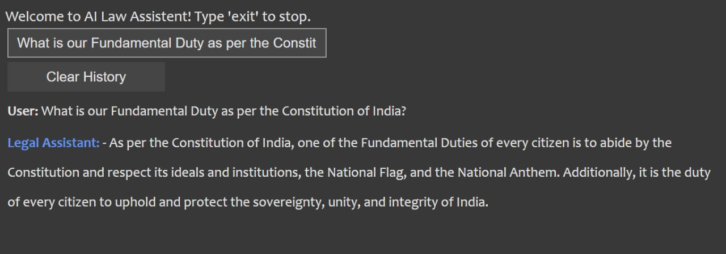
Outcomes/ Results Obtained
Chatbot responding to a legal query on fundamental rights

Slide 13
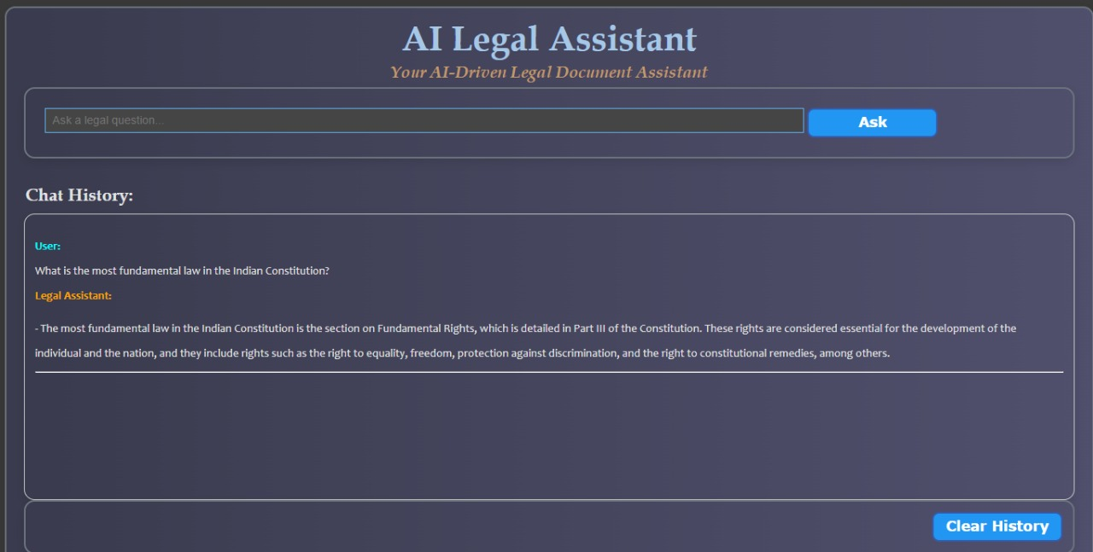
Outcomes/ Results Obtained
Response to a query on Fundamental Law by the Assistant

Slide 14
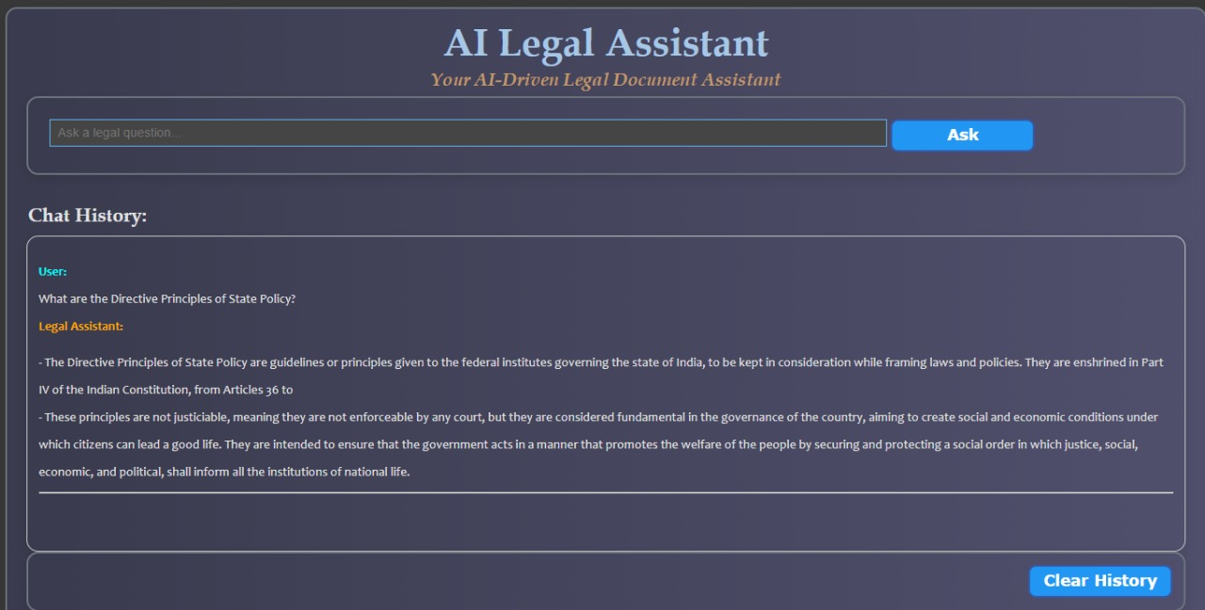
Outcomes/ Results Obtained
Response to a query on Directive Principles by the Assistant

Slide 15
Conclusion
Simplifies legal drafting by generating accurate, easy-to-understand documents using NLP and machine learning.
Designed for efficiency, usability, and compliance.
Integrates with legal resources to stay aligned with legal standards.
Reduces time, effort, and cost, improving legal access for individuals and small businesses in India.

Slide 16
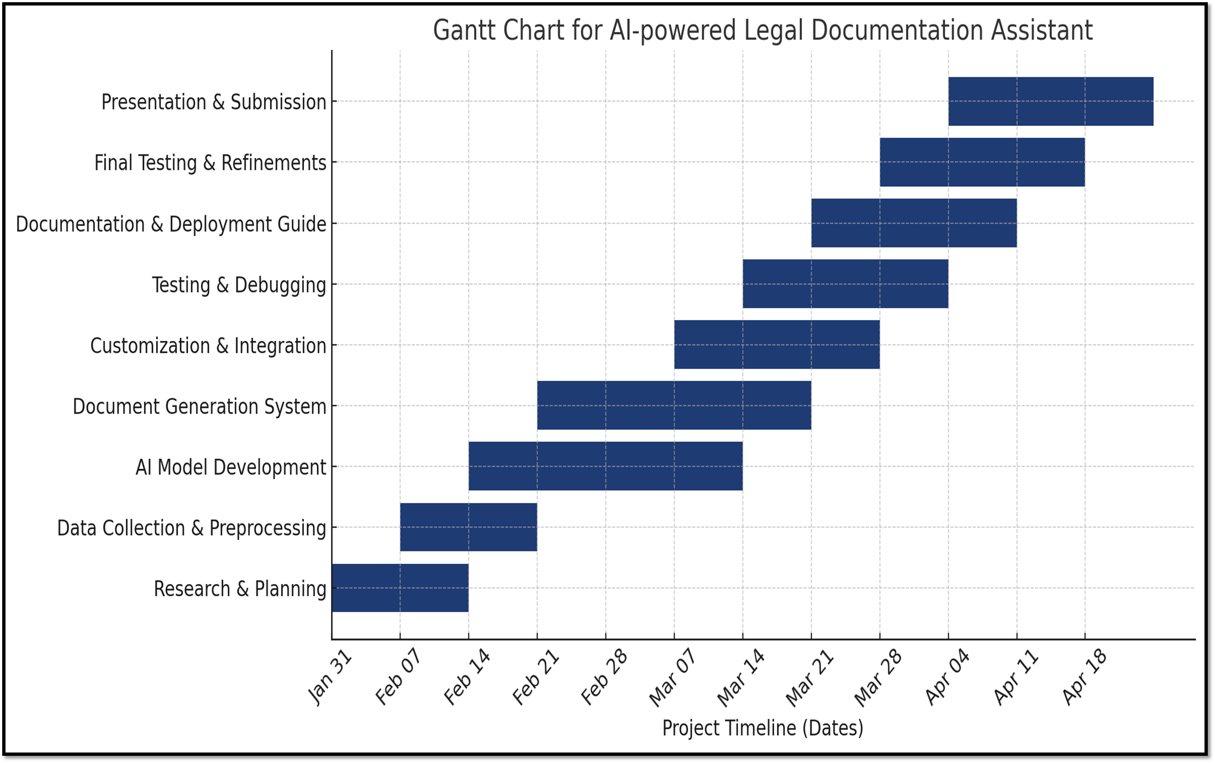
Timeline of the Project (Gantt Chart)

Slide 17
GitHub Link
The GitHub link provided should have public access permission.
https://github.com/vaishnavi-c-2025/AI-powered-Legal-Documentation-Assistant

Slide 18
References (IEEE Paper format)
[1]. Rithik Raj Pandey, Sarthak Khandelwal, Satyam Srivastava, Yash Triyar and Mrs. Muquitha Almas, “LegalSeva: AI - Powered Legal Documentation Assistant”, International Research Journal of Modernization in Engineering Technology and Science, vol. 06/Issue:03, March 2024.
[2]. Imogen Vimala, Sreenidhi J. and Nivedha V, “AI - Powered Legal Documentation Assistant”, Journal of Artificial Intelligence and Capsule Networks. 6. 210-226. 10.36548/jaicn.2024.2.007.
[3]. Awez Shaikh, Rizvi Mohd Farhan, Zahid Zakir Hussain and Shaikh Azlaan, "AI - Powered Legal Documentation Assistant", International Journal of Emerging Technologies and Innovative Research (www.jetir.org), ISSN:2349-5162, Vol.11, Issue 4, page no. k526-k530, April-2024.
[4]. G. Kiran Kumar, A. Shreyan, G. Harini, M. Balaram, (2024), “AI - Powered Legal Documentation Assistant”, International Journal of Engineering Innovations and Management Strategies 1 (1):1-13.

Slide 19
References (IEEE Paper format)
[5]. Lalita Panika, Aastha Gracy, Abhishek Khare, Sanket Mathur and S. Hariharan Reddy,
“SimpliLegal: An AI - Powered Legal Document Assistant”, International Research Journal of
Modernization in Engineering Technology and Science, vol. 06/Issue:04, April 2024.
[6]. M. E. Kauffman and M. N. Soares, "AI in legal services: New trends in AI-enabled legal
services," Service Oriented Computing and Applications, vol. 14, pp. 223–226, Oct. 2020, doi:
10.1007/s11761-020-00305-x.
[7]. S. Kapoor, P. Henderson, and A. Narayanan, "Promises and pitfalls of artificial intelligence
for legal applications," arXiv, Feb. 6, 2024.
[8]. L. B. Eliot, "AI and Legal Argumentation: Aligning the Autonomous Levels of AI Legal
Reasoning," arXiv preprint arXiv:2009.11180, 2020.
[9]. J. Cui, M. Ning, Z. Li, B. Chen, Y. Yan, H. Li, B. Ling, Y. Tian, and L. Yuan, "Chatlaw: A
Multi-Agent Collaborative Legal Assistant with Knowledge Graph Enhanced Mixture-of-Experts
Large Language Model," arXiv preprint arXiv:2306.16092, May 2024.

Slide 20
References (IEEE Paper format)
[10]. Q. Steenhuis, D. Colarusso, and B. Willey, "Weaving Pathways for Justice with GPT: LLM-
driven Automated Drafting of Interactive Legal Applications," arXiv preprint arXiv:2312.09198,
Dec. 2023.
[11]. D. Shah, J. Vasi, T. Gandhi, and K. Dabre, "AI & ML Based Legal Assistant," International
Research Journal of Engineering and Technology (IRJET), vol. 11, no. 07, pp. 706-708, Jul.
2024.
[12]. J. Aroraa, T. Patankara, A. Shaha, and S. Joshia, "Artificial Intelligence as Legal Research
Assistant," in Forum for Information Retrieval Evaluation (FIRE), Hyderabad, India, Dec. 2020.
[13]. P. N. Devaraj, R. T. P. V, M. K. R, and A. Gangrade, "Development of a Legal Document AI-
Chatbot," School of Computer Science and Engineering, Vellore Institute of Technology,
Chennai, India.
[14]. J. Lai, W. Gan, J. Wu, Z. Qi, and P. S. Yu, "Large Language Models in Law: A Survey,"
arXiv preprint, arXiv:2312.03718, Nov. 2023.
[15]. Nguyen, H. T., "A Brief Report on LawGPT 1.0: A Virtual Legal Assistant Based on GPT-3,"
arXiv preprint arXiv:2302.05729v2, 2023.

Slide 21

Project work mapping with SDG

Slide 22
Project work mapping with SDG
SDG 16: Peace, Justice and Strong Institutions
Our project strengthens justice and legal institutions by making legal knowledge more accessible and understandable to the public. It empowers citizens to exercise their rights, understand legal procedures, and access justice digitally, especially those with limited resources.
2. SDG 10: Reduced Inequalities
By offering free and easy-to-use legal assistance, our project helps bridge the gap between those who can afford legal services and those who cannot. It reduces inequalities in access to justice and legal literacy, supporting inclusion and social equity.
3. SDG 9: Industry, Innovation and Infrastructure
Our AI-powered legal assistant introduces innovation in the legal sector, promoting digital transformation. It builds intelligent infrastructure for legal services and fosters growth in AI-driven legal tech solutions.
4. SDG 4: Quality Education
The project contributes to legal education by helping users learn about constitutional rights, laws, and legal terms. It supports lifelong learning and awareness, especially in academic and community learning environments.

Slide 23
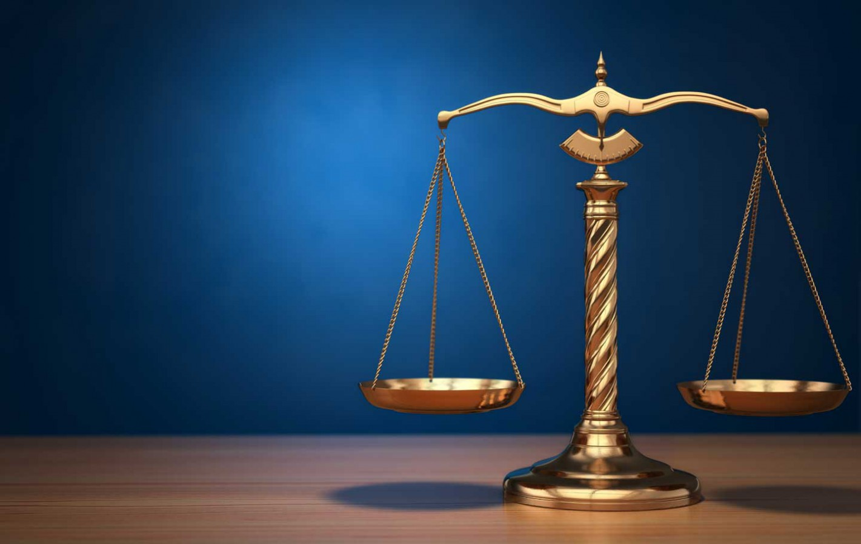
Thank You

